Slide 1


micro:bit robot entry tutorial
Lesson 8
micro:bit robot lesson 8 “Ultrasonic obstacle avoidance”
YahBoom micro:bit video tutorial

Slide 2
micro:bit robot entry tutorial
Content
Part1
Part 2
Part3
Part 4
Learning goals
Preparation
Search for blocks
Combine blocks
YahBoom micro:bit video tutorial

Slide 3
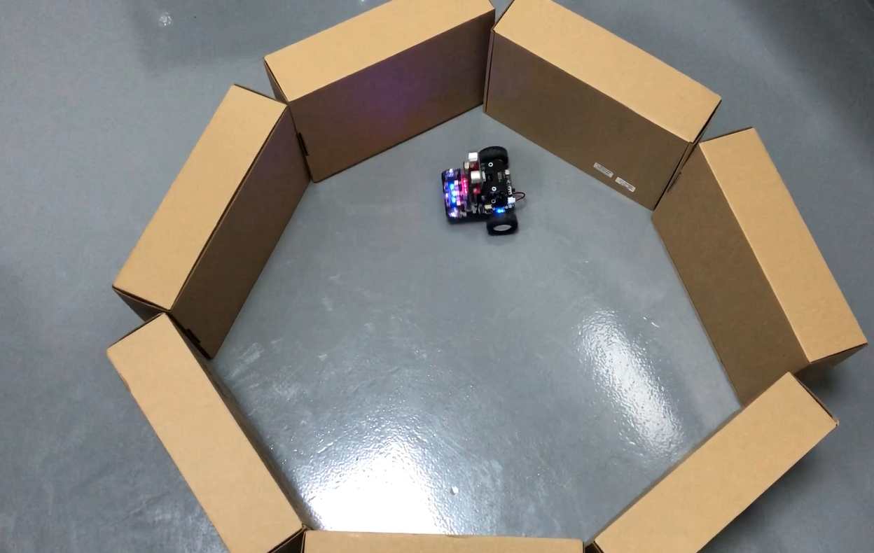
micro:bit robot entry tutorial
Part 1
Learning goals
Children, what we need to learn in this lesson is robot ultrasonic obstacle avoidance. We can set up a roadblock to the front of the robot (or a loop of cartons for a robot to run inside), and then we can see that the robot will go all the way, and if there are obstacles in front of the robot, it will escape the barrier. Let's try the kids together.
YahBoom micro:bit video tutorial

Slide 4
micro:bit robot entry tutorial
Part 2
Hardware:
● 1 X USB cable
● 1 X micro:bit robot
Preparation
Then the micro:bit is connected to the computer through USB, and the computer will pop up a U disk and click the URL in the U disk to enter the programming interface. Input this URL https://github.com/lzty634158/yahboom_mbit_en to get the package.
YahBoom micro:bit video tutorial

Slide 5
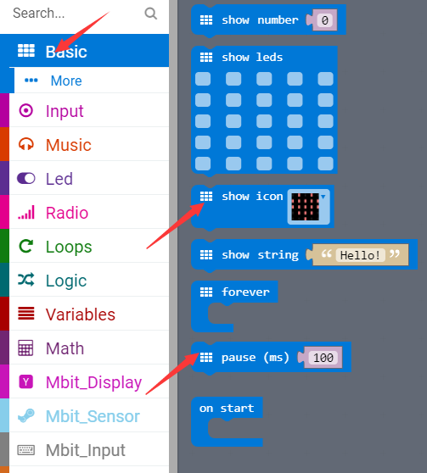
micro:bit robot entry tutorial
Part 3
Search for blocks
YahBoom micro:bit video tutorial

Slide 6
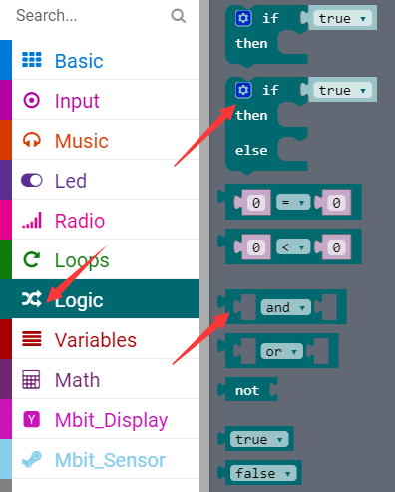
micro:bit robot entry tutorial
Part 3
Search for blocks
YahBoom micro:bit video tutorial

Slide 7
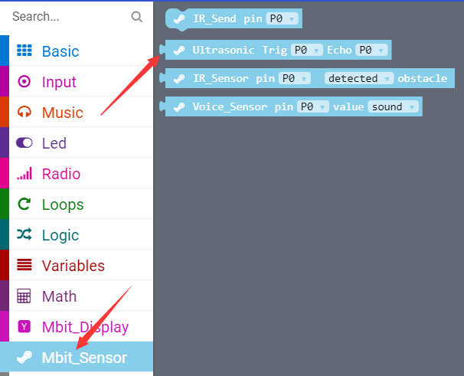
micro:bit robot entry tutorial
Part 3
Search for blocks
YahBoom micro:bit video tutorial

Slide 8
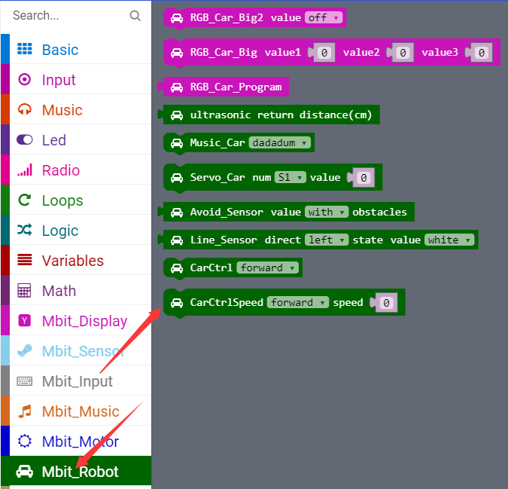
micro:bit robot entry tutorial
Part 3
Search for blocks
YahBoom micro:bit video tutorial

Slide 9
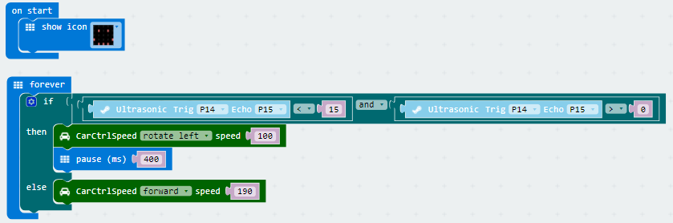
micro:bit robot entry tutorial
Part 4
In this lesson, children should check their own ultrasonic connection. VCC corresponds to VCC and GND corresponds to GND. In addition, the demand for voltage is higher than that of ultrasonic. It is recommended to fill up the electric capacity and do the experiment again.
Combine blocks
YahBoom micro:bit video tutorial

Slide 10
micro:bit robot entry tutorial
robot
lesson
Thanks for watching！
Powered by YahBoom
YahBoom micro:bit video tutorial

